Slide 1
Python Programming - II
-By Nimesh Kumar Dagur, CDAC, India

Slide 2
Employee
(Base class/Parent class/Super Class)
X
Name,
address,
EmailID,
contactno
value
FT_Employee
PT_Employee
salaryMode_monthly
salaryMode_hourly

Slide 3
Standard Data Types:
The data stored in memory can be of many types.
For example, a person's age is stored as a numeric value and his or her address is stored as alphanumeric characters.
Python has various standard types that are used to define the operations possible on them and the storage method for each of them.

Slide 4
Standard Data Types:
Python has following standard data types:
Numbers
String
List
Tuple
Dictionary
set

Slide 5
Working With Numbers
The interpreter acts as a simple calculator: you can type an expression at it and it will write the value.
Expression syntax is straightforward:
operators +, -, * and / work just like in most other languages (for example, C);
parentheses can be used for grouping.

Slide 6
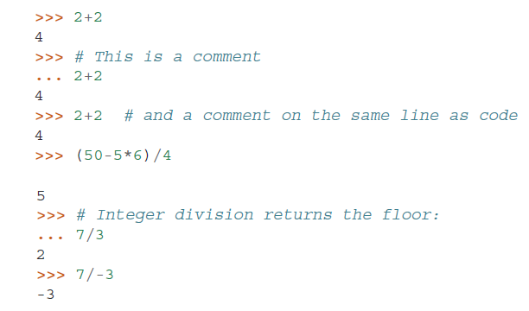
Examples

Slide 7
Python Numbers
Python supports following different numerical types
int (signed integers): positive or negative whole numbers with no decimal point.
long (long integers ): integers of unlimited size, written like integers and followed by an uppercase or lowercase L. It is not supported in Python 3.x version.
float (floating point real values) :represent real numbers and are written with a decimal point dividing the integer and fractional parts.
Floats may also be in scientific notation, with E or e indicating the power of 10 (2.5e2 = 2.5 x 10² = 250).
complex (complex numbers) : are of the form a + bJ, where a and b are floats and J (or j) represents the square root of -1 (which is an imaginary number).
The real part of the number is a, and the imaginary part is b.

Slide 8

Working With Numbers
The equal sign (’=’) is used to assign a value to a variable. Afterwards, no result is displayed before the next interactive prompt:

Slide 9
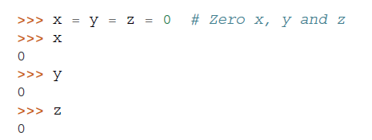
Working With Numbers
A value can be assigned to several variables simultaneously:

Slide 10
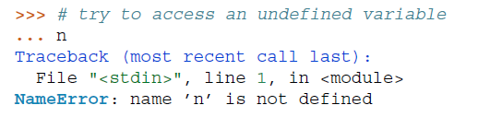
Working With Numbers
Variables must be “defined” (assigned a value) before they can be used, or an error will occur:

Slide 11

Working With Numbers
There is full support for floating point; operators with mixed type operands convert the integer operand to floating point:
a+bj
0+1j

Slide 12
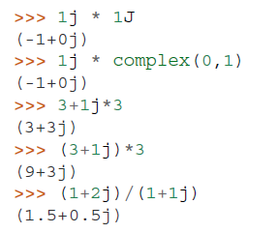
Working With Numbers
Complex numbers are also supported;
imaginary numbers are written with a suffix of j or J.
Complex numbers with a nonzero real component are written as (real+imagj), or can be created with the complex(real, imag) function.

Slide 13
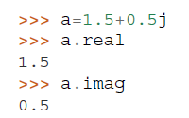
Working With Numbers
Complex numbers are always represented as two floating point numbers, the real and imaginary part.
To extract these parts from a complex number z, use z.real and z.imag.

Slide 14
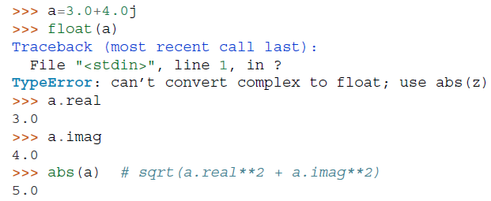
Working With Numbers
The conversion functions to floating point and integer (float(), int() and long()) don’t work for complex numbers — there is no one correct way to convert a complex number to a real number.
Use abs(z) to get its magnitude (as a float) or z.real to get its real part.

Slide 15


Mathematical Functions
abs() : The method abs() returns absolute value of x - the (positive) distance between x and zero.
Syntax
Example

Slide 16

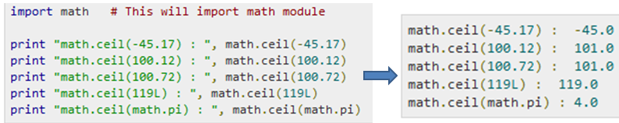
Mathematical Functions
ceil() : The method ceil() returns ceiling value of x - the smallest integer not less than x.
Syntax
x is a numeric expression.
Example

Slide 17

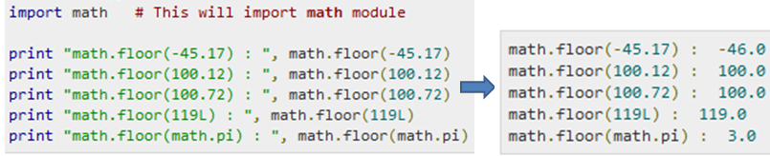
Mathematical Functions
floor() : The method floor() returns floor of x - the largest integer not greater than x.
Example

Slide 18
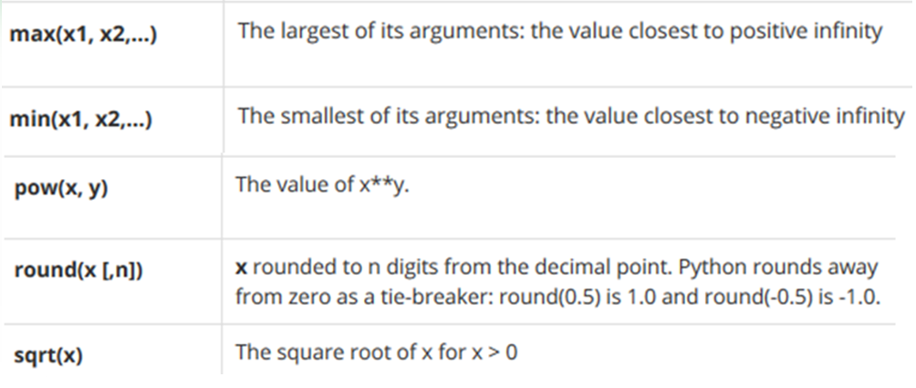
Mathematical Functions

Slide 19
Python Strings
Strings in Python are identified as a contiguous set of characters in between quotation marks.
Python allows for either pairs of single or double quotes.
Subsets of strings can be taken using the slice operator ( [ ] and [ : ] ) with indexes starting at 0 in the beginning of the string and working their way from -1 at the end.
The plus ( + ) sign is the string concatenation operator and the asterisk ( * ) is the repetition operator

Slide 20
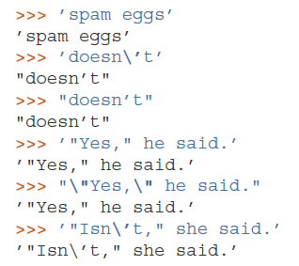
Working With Strings
Besides numbers, Python can also manipulate strings, which can be expressed in several ways.
They can be enclosed in single quotes or double quotes:

Slide 21
Working With Strings
String literals can span multiple lines in several ways.
Continuation lines can be used, with a backslash as the last character on the line indicating that the next line is a logical continuation of the line:
Note that newlines still need to be embedded in the string using \n; the newline following the trailing backslash is discarded.
strings can be surrounded in a pair of matching triple-quotes: """ or ”’.
End of lines do not need to be escaped when using triple-quotes, but they will be included in the string.

Slide 22
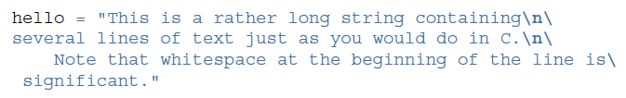

Working With Strings

Slide 23
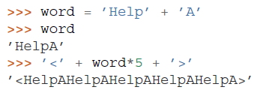
Working With Strings
Strings can be concatenated with the + operator, and repeated with *:

Slide 24
Working With Strings
Two string literals next to each other are automatically concatenated;
the first line above could also have been written
word = ’Help’ ’A’;
this only works with two literals, not with arbitrary string expressions:

Slide 25
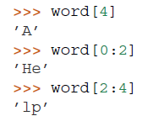
Working With Strings
Strings can be subscripted (indexed); like in C, the first character of a string has subscript (index) 0.
substrings can be specified with the slice notation: two indices separated by a colon.
Word=“HelpA”

Slide 26
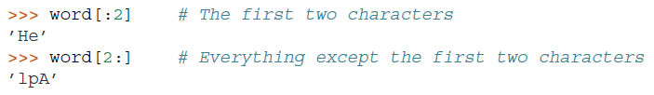
Working With Strings
Slice indices have useful defaults; an omitted first index defaults to zero, an omitted second index defaults to the size of the string being sliced.
Word=“HelpA”

Slide 27


Working With Strings
creating a new string with the combined content is easy and efficient:
Here’s a useful invariant of slice operations:
s[:i] + s[i:] equals s.

Slide 28
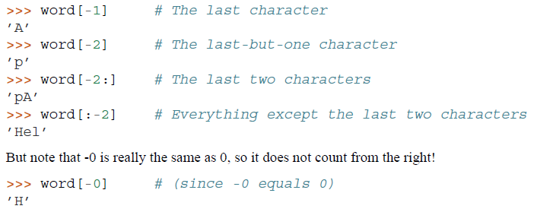
Working With Strings
Indices may be negative numbers, to start counting from the right.

Slide 29

Working With Strings
The built-in function len() returns the length of a string:

Slide 30
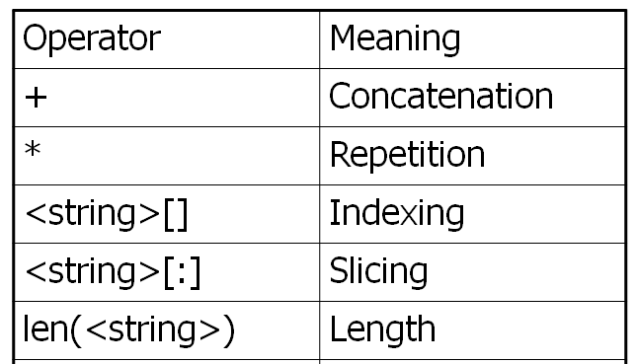
String Data Type

Slide 31

Built-in String Methods
capitalize(): It returns a copy of the string with only its first character capitalized.
str.capitalize ( )
(
)

Slide 32

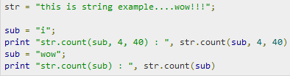

Built-in String Methods
count(): The method count() returns the number of occurrences of substring sub in the range [start, end].

Slide 33

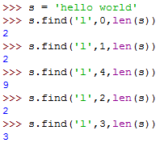
Built-in String Methods
find(): It determines if string str occurs in string, or in a substring of string if starting index beg and ending index end are given.
,
Index if found and -1 otherwise.

Slide 34


Built-in String Methods
lower(): The method lower() returns a copy of the string in which all case-based characters have been lowercased.

Slide 35

Built-in String Methods
upper() :The method upper() returns a copy of the string in which all case-based characters have been uppercased.
swapcase(): The method swapcase() returns a copy of the string in which all the case-based characters have had their case swapped.
title(): The method title() returns a copy of the string in which first characters of all the words are capitalized.
replace() : The method replace() returns a copy of the string in which the occurrences of old have been replaced with new, optionally restricting the number of replacements to max.

Slide 36
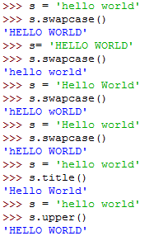
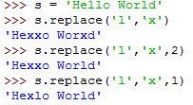

Slide 37
Data Type Conversion
Sometimes, you may need to perform conversions between the built-in types.
To convert between types, you simply use the type name as a function.
There are several built-in functions to perform conversion from one data type to another.
These functions return a new object representing the converted value.

Slide 38
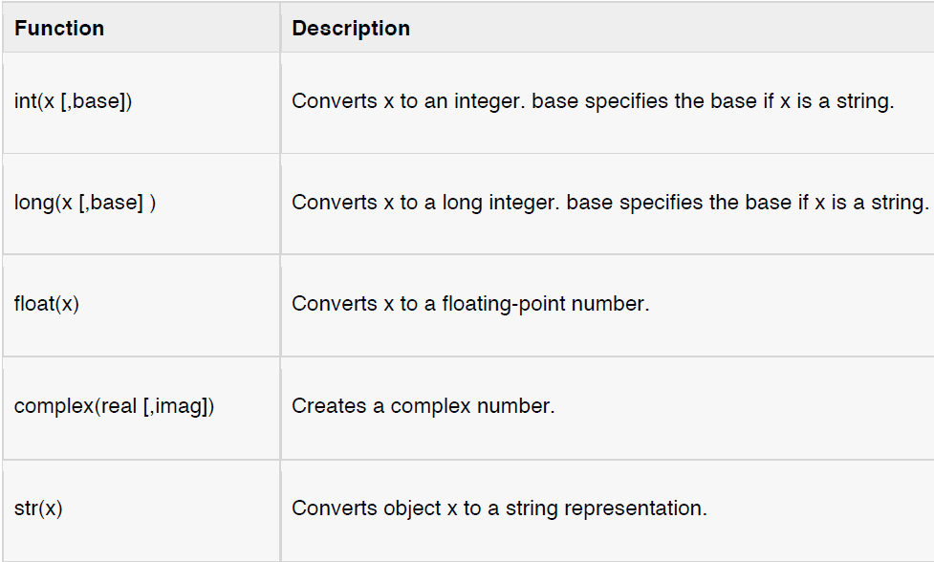
Data Type Conversion

Slide 39
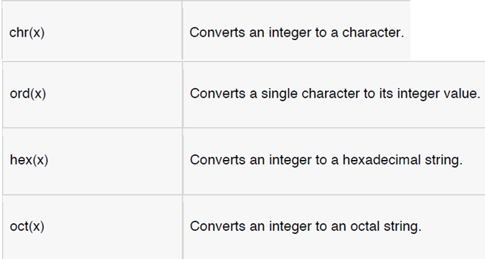
Data Type Conversion

